Slide 1
Case Study in Image Analytics
Cricket Shot Prediction

Slide 2
Contents
Cricket Shot Prediction – Objective and Motivation
Cricket Shot Prediction – Model Training and Testing
Cricket Shot Prediction - Model Deployment

Slide 3
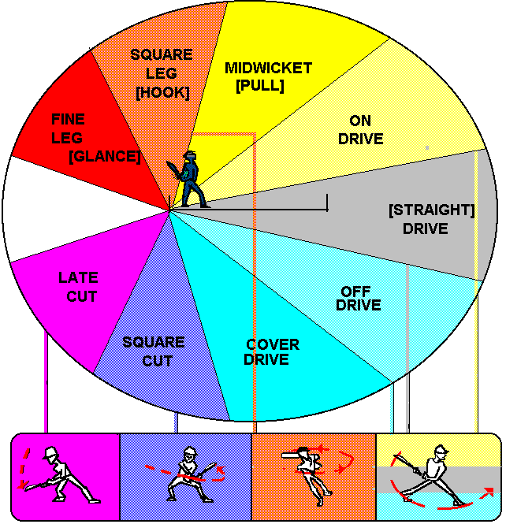
Cricket Shot Prediction
In cricket, various types of shots played by a batsman are identified
Drive
Leg Glance or Flick shot
Sweep Shot
Pull Shot
Hook
Cut Shot
Objective: Developing a cricket shot prediction model using image analysis
Images of the batsmen playing a shot are used as input

Slide 4
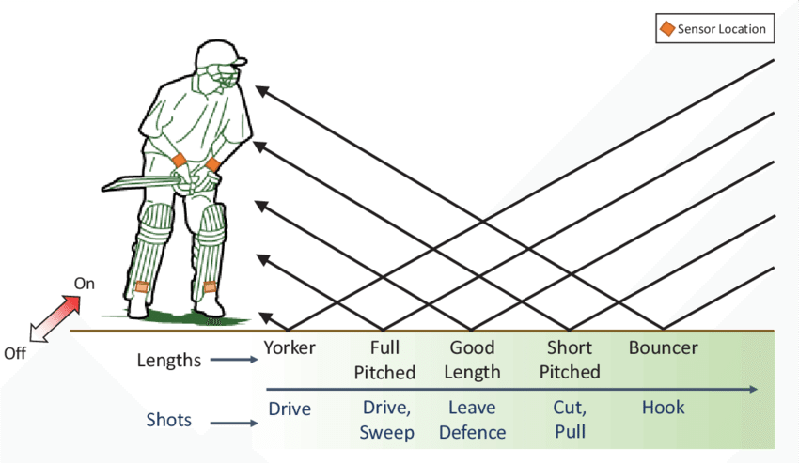
Motivation and Formulation
Motivation: Benefiting commentators, viewers and leaners of the game with insights into the shots played
Can be used to develop an AI system which automatically generates commentary
Formulation: Classification problem with each type of shot considered as a class
Relation between image and class of shot to be learnt from data

Slide 5
Formulation
Classifier
Input-Output Relation
Output class
(Type of cricket shot)
Input
(Image of batsman playing cricket shot)
Feedback: Input-Output data

Slide 6
Step 1: Data Collection
Data Collection
Collect relevant data along with class label

Slide 7
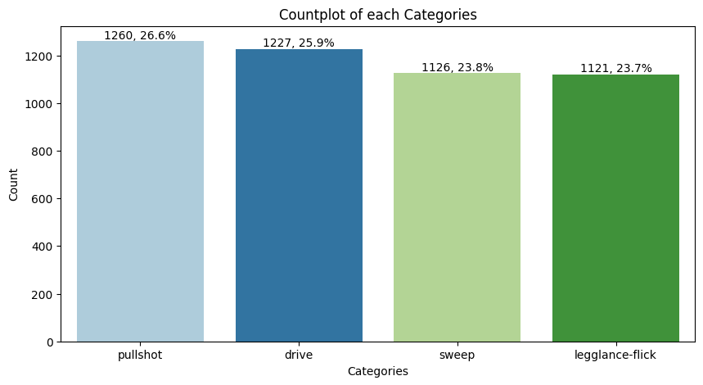
Dataset
Kaggle dataset with images of 4 different cricket shots (4 classes) is taken
Total number of images are 4734
Shots (Class) | Count
Pull shot | 1260
Drive shot | 1227
Sweep shot | 1126
Flick shot | 1121

Slide 8
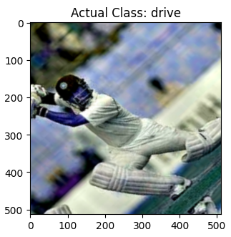
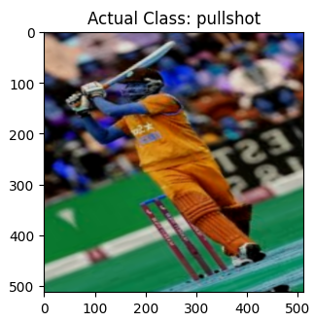
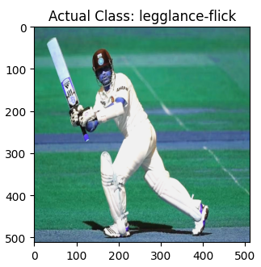
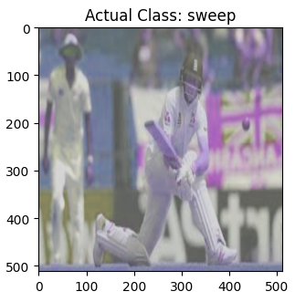
Sample Images from Dataset

Slide 9
Step 2: Data Preparation
Data Collection
Collect relevant data along with class label
Data Preparation
Clean the data and fill any missing values
Pre-process the data as necessary

Slide 10
Data Processing
Split the dataset in the ratio of 80:20 for training and testing
Training set contains 3786 images.
Test set contain 946 images
Stratification: Ensure proportions of each class of samples remain the same in train and test set
Issue with Training Set:
Size of training set not sufficient for training a good classifier
Hence data augmentation of the training set is performed
In data augmentation, new samples are added by transforming the existing samples in different ways

Slide 11
Data Augmentation Approaches Used
Horizontal flipped: Mirrored horizontally.
Vertical flipped: Mirrored vertically
Rotation: Rotate image by a certain angle
Cropped Image: From all the four sizes, we remove 200 pixels.
Brightened Image: For every pixels we increase the value by 5 percentage.
Darkened Image: For every pixels we decrease the value by 5 percentage.
Resize: Change the resolution or size of the image
Noise: For each image, we generate a random number between -10 and 10, and then change the pixel values by that percentage.

Slide 12
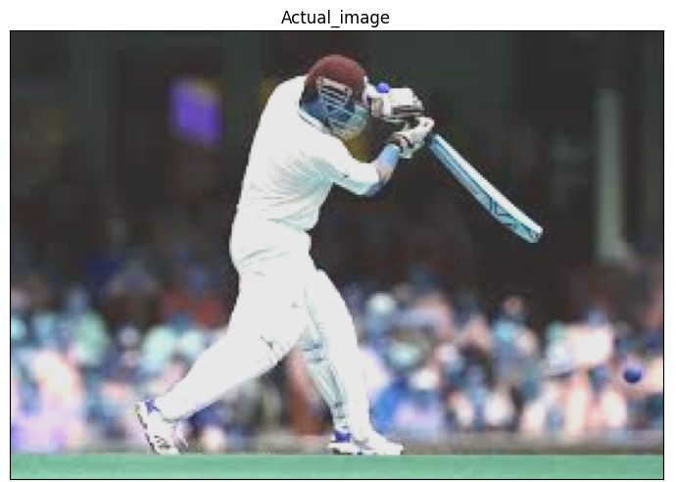
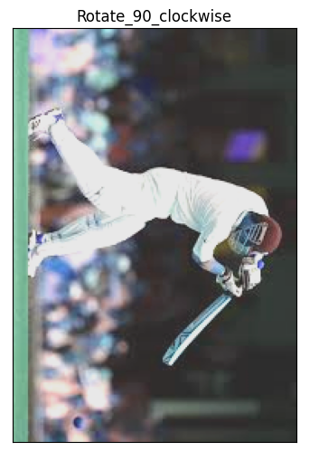
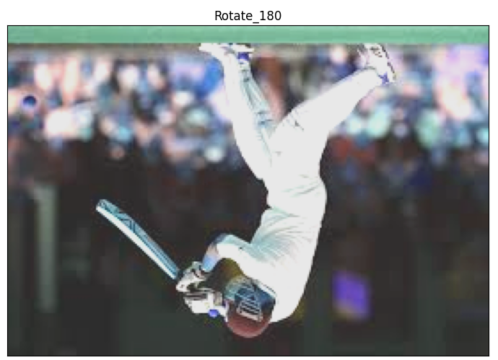
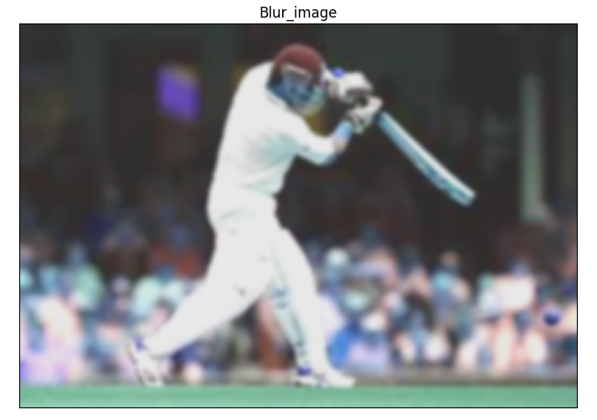
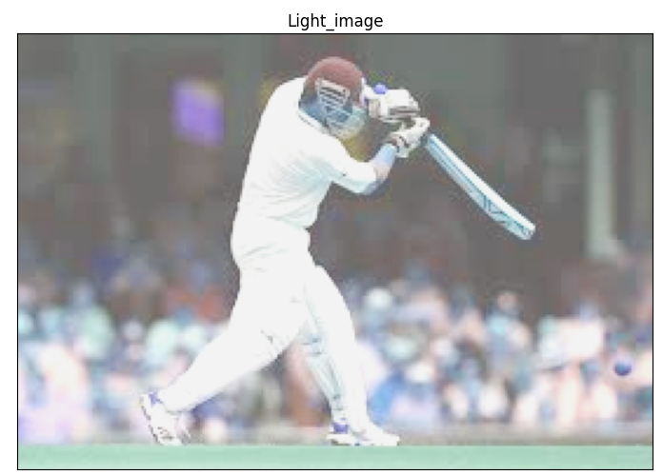
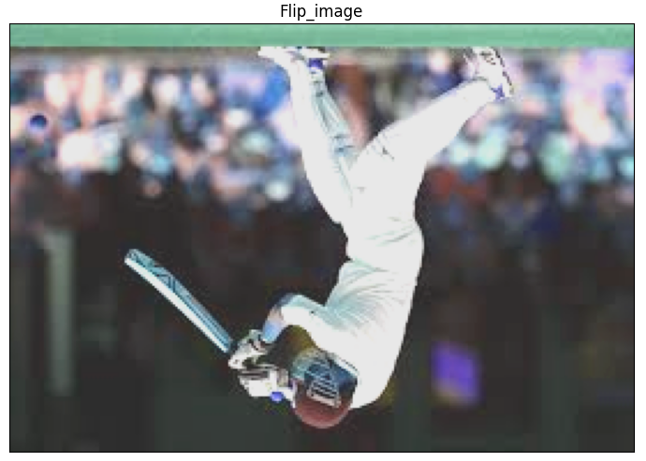
Augmentation on a Sample Image

Slide 13
Step 3: Build Classifier
Data Collection
Collect relevant data along with class label
Data Preparation
Clean the data and fill any missing values
Pre-process the data as necessary
Build Classifier
Train classifier by learning relation between input features and output classes

Slide 14
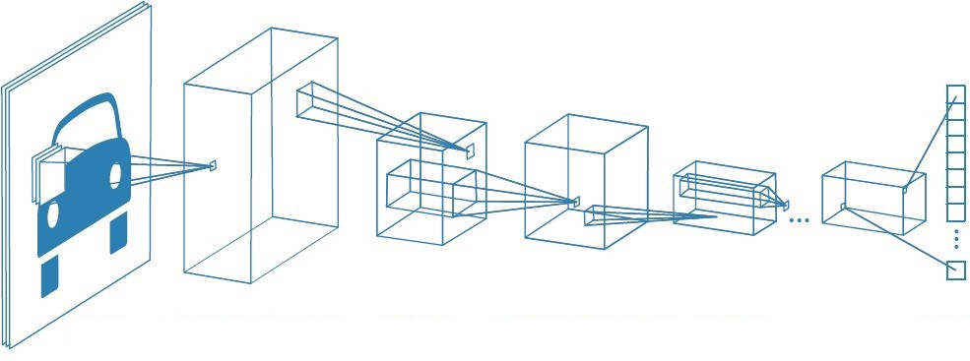
Convolution Neural Network
Convolution Layer
Convolution
layer
Pooling
layer
Pooling
Layer
Flattening
Input layer
Relevant features can be extracted from an image using a CNN

Slide 15
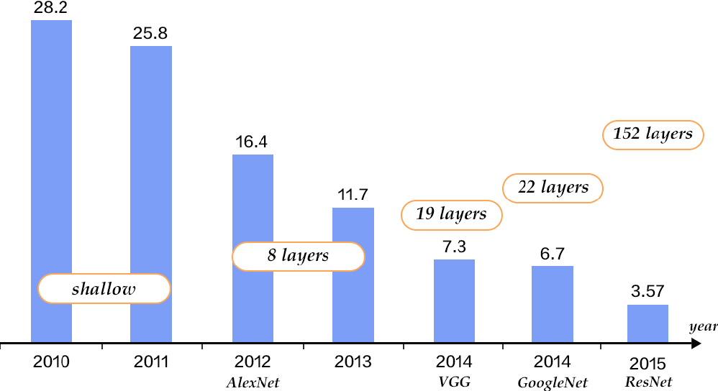
Power of CNNs: Image Net Challenge
Image classification task with 1000 classes
Training data of 1.2 million images
Humans had an error rate of around 5%

Slide 16
Training a CNN
Training a CNN involves learning the convolution filter weights
Referred to as parameters of a CNN
Number of parameters in a CNN depends on filter size and number of filters
Issue:
CNNs require lot of data for training
CNNs are computationally expensive to train
Not everyone can afford multiple GPUs
$$\begin{matrix}y_{11} & y_{12} \\ y_{21} & y_{22}\end{matrix}$$
Convolution
filter
AlexNet – 62 mil params
VGGNet – 138 mil params
GoogleNet – 4 mil params
ResNet18 – 11 mil params
ResNet50 – 23 mil params
Inception v3 - 25 million params
Xception – 22.8 million params
ResNET152 – 60 mil params

Slide 17
Training a CNN
AlexNet – 62 mil params
VGGNet – 138 mil params
GoogleNet – 4 mil params
ResNet18 – 11 mil params
ResNet50 – 23 mil params
Inception v3 - 25 million params
Xception – 22.8 million params
ResNET152 – 60 mil params
Issue:
CNNs require lot of data for training
CNNs are computationally expensive to train
Not everyone can afford multiple GPUs
Question: How to overcome this challenge?
Can we re-use already trained CNN models and customise them to our task?
Yes! Transfer learning to the rescue.

Slide 18
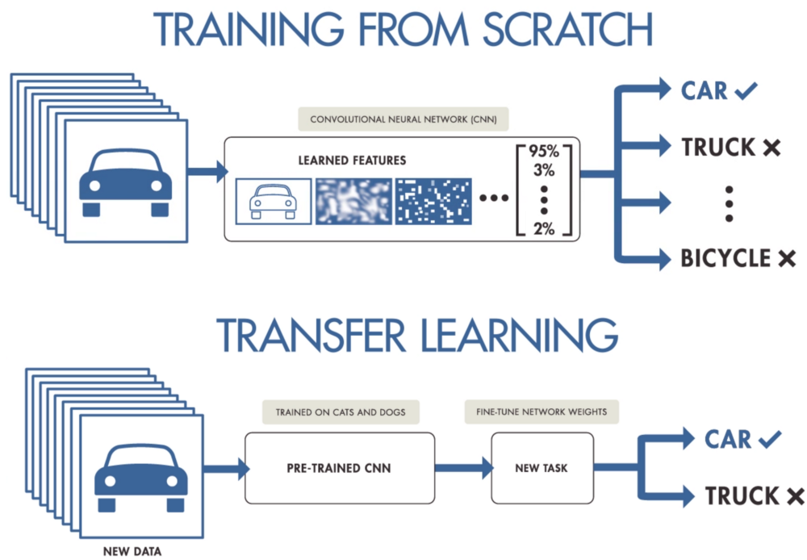
Transfer Learning
CNNs are basically feature-extractors
Trained models have many layers capable to extract relevant features from any image
So there is no need to learn models from scratch
Transfer learning involves re-using a trained model
Model is then tuned to the task at hand

Slide 19
Approaches to Building Classifier
Develop a Convolutional Neural Network (CNN) based classifier from scratch
Requires lot of data and computation power to train CNN models from scratch
Leverage pre-trained CNN models, such as Inception v3, ResNet-50, Xception, etc. to build a classifier
Most suitable because of the possibility of transferring the past learnings of the models

Slide 20
Approach Used to Building Classifier
Following pre-trained models were considered:
Inception V3.
Xception
Transfer learning is performed on each of the models
Some of the layers of the pre-trained models were tuned using the augmented training set of images

Slide 21
Step 4: Test Classifier
Data Collection
Collect relevant data along with class label
Data Preparation
Clean the data and fill any missing values
Pre-process the data as necessary
Build Classifier
Train classifier by learning relation between input features and output classes
Test Classifier
Assess the classifier performance

Slide 22
Confusion matrix
A table or a matrix with different combinations of predicted and actual values for different classes
Used to track the number of correctly and wrongly predicted samples by the classifier
 | Predicted(sweep) | Predicted(drive) | Predicted(pull shot) | Predicted(flick)
Actual(sweep) | Correctly classified | Incorrectly classified | Incorrectly classified | Incorrectly classified
Actual(drive) | Incorrectly classified | Correctly classified | Incorrectly classified | Incorrectly classified
Actual(pull shot) | Incorrectly classified | Incorrectly classified | Correctly classified | Incorrectly classified
Actual(flick) | Incorrectly classified | Incorrectly classified | Incorrectly classified | Correctly classified

Slide 23
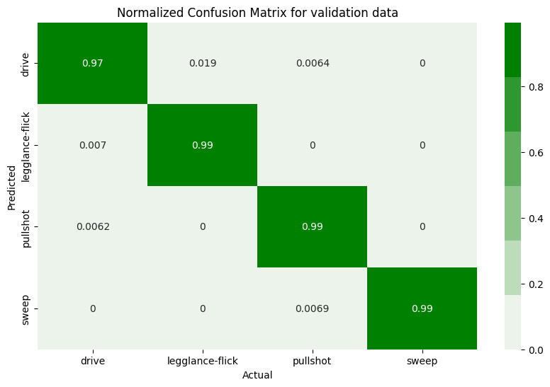
Confusion Matrix for Inception v3
On test set of 946 images

Slide 24
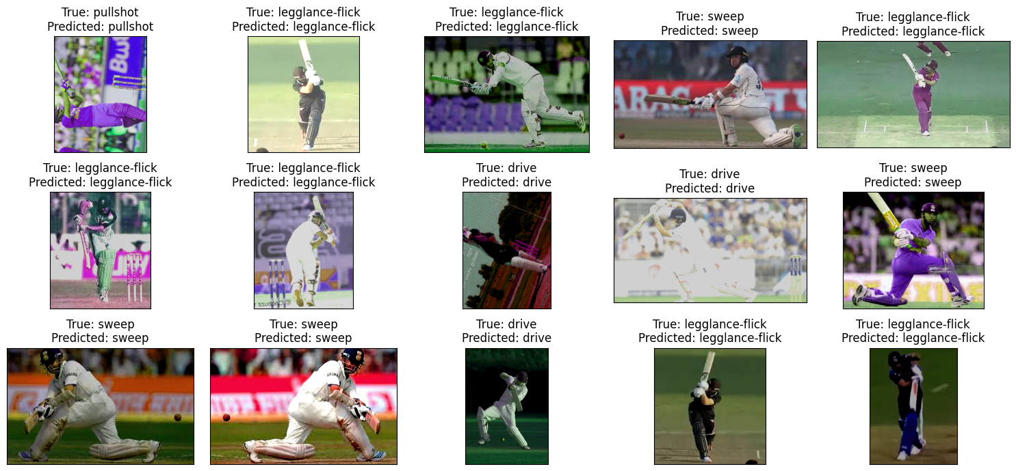
Images Correctly Classified

Slide 25

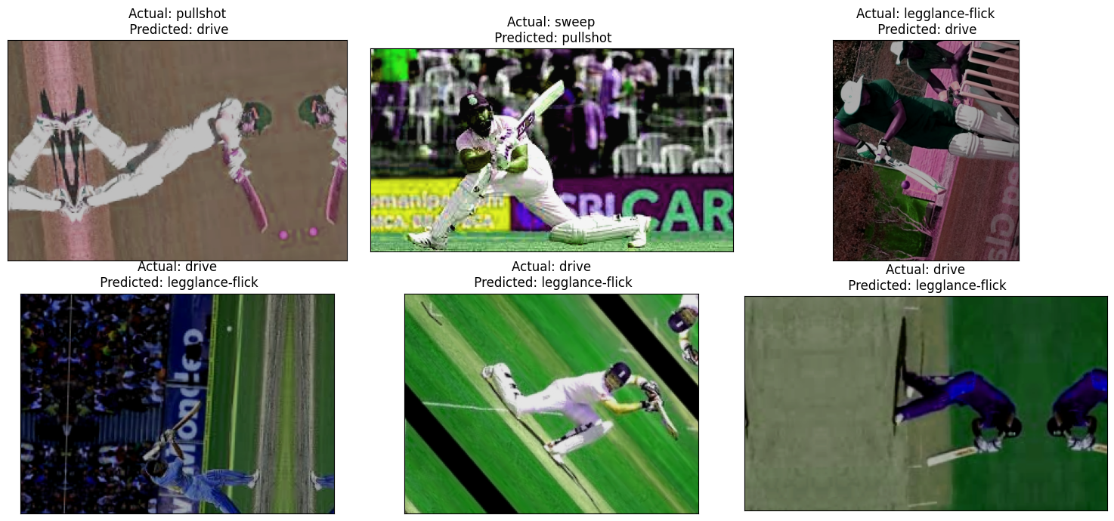
Images Incorrectly Classified

Slide 26

Confusion Matrix for Xception
On test set of 946 images

Slide 27
Images Correctly Classified

Slide 28
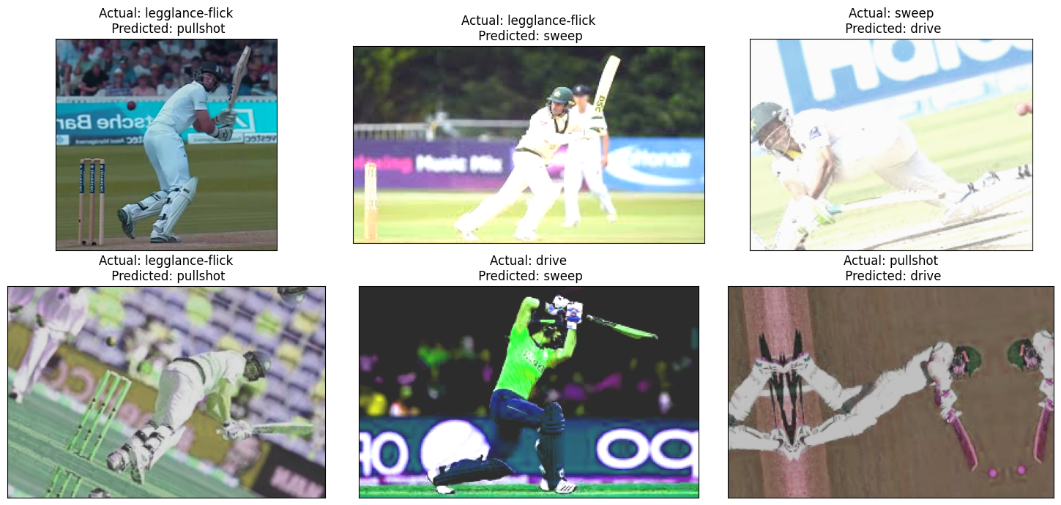
Images Incorrectly Classified

Slide 29
Comparison of Accuracy
Model | Test Accuracy
Inception V3 | 98.59 %
Xception | 94.79 %

Slide 30
Model Deployment

Slide 31
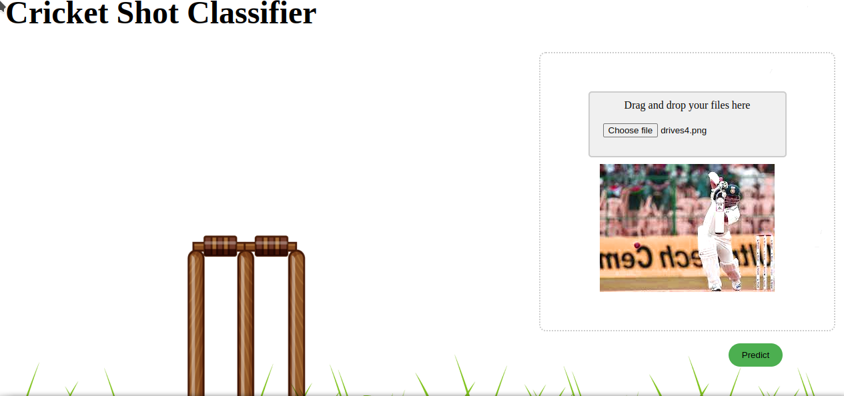
Model Deployment
Simple UI is created to deploy the model
Images of cricket shots can be uploaded to generate predictions

Slide 32
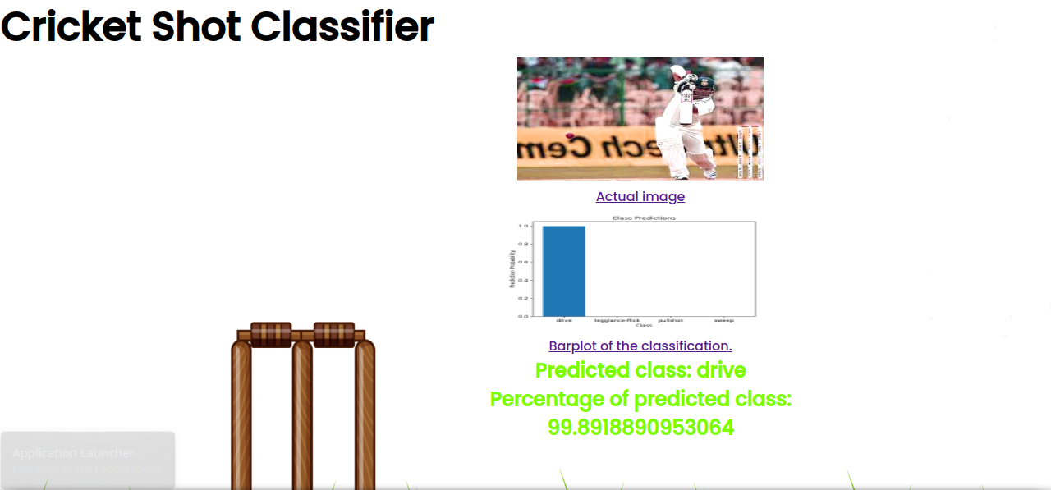
Sample Prediction

Slide 33
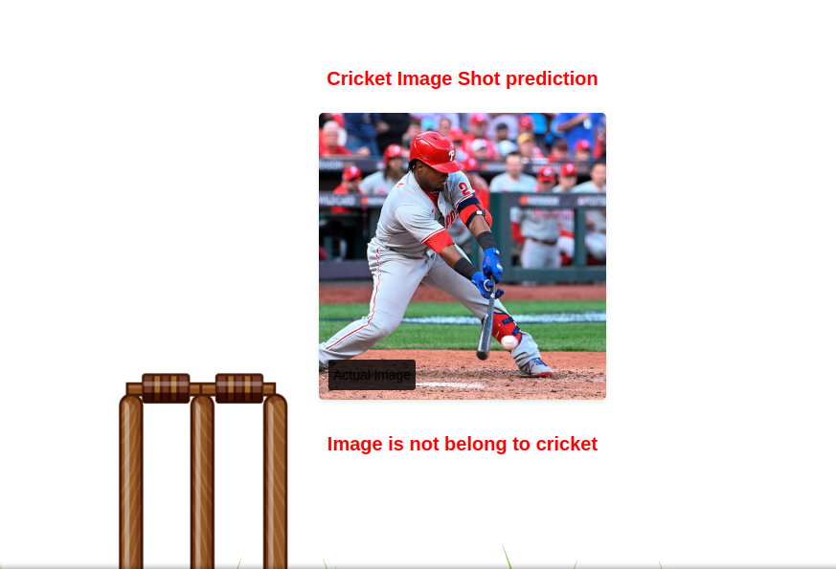
Sample Prediction
Images not containing cricket shots are flagged

Slide 34
Summary
Predicting type of cricket based on Image of a batman playing a cricket shot can be formulated as an Image Classification problem
Data collection involves collecting images of different types of cricket shots played by different batsmen
Data augmentation is to be performed since the number of images available for building classifier are limited
Classifiers which use CNNs are most effective for this use case
Transfer learning is preferred because learning a CNN based classifier from scratch requires lot of computation power and training data
Accuracy is a suitable metric for evaluating the performance of a classifier

Slide 35

THANK YOU

